Slide 1
Katje’s Crash Course in claim code sets
With a special look at icd-10cm-pcs (FY2022 Code Sets)

Slide 2
Claim Forms – Part A vs Part B
Medicare Part A Charges: CMS–1450
Medicare Part B Charges: CMS-1500
More commonly known as the UB or Universal Bill.
UB-04 replaced UB-92 in 2007. Same form with more fields.
Used for submitting institutional charges covered by Medicare Part A. Part A coverage roughly equates to a facility/hospital/nursing home. Not always. Private payors can/do have their own rules.
Electronic version is 837i.
Utilizes ICD and HCPCS codes sets.
Also knows as “the red form”
Has always been “the 1500”
Used for submitting charges covered by Medicare Part B. Part B coverage roughly equates to the doctor/provider. Not always. Private payors can/do have their own rules.
Electronic version is 837p.
Utilizes ICD and HCPCS codes sets.

Slide 3
ICD Code setS – icd-10 and icd-10-pcs
ICD stands for the International Classification of Diseases.
ICD codes describe the physician’s diagnosis and patient’s condition and justifies the medical necessity of services provided.
ICD code set was established by the World Health Organization (WHO) in the 1940s and, as the name implies, is used around the globe in almost all countries. Therefore, ICD represents a uniform universal vocabulary for healthcare around the world. Roughly, 121 countries use the WHO published version of ICD-10 and 29 other countries use an enhanced version of ICD-10.
ICD code sets have versions and are commonly referred to by their version number i.e. ICD-9, ICD-10. The USA delayed implementing version 10 for a decade. Finally implemented October 1st, 2015. WHO published ICD-11 on May 25, 2019.
ICD code sets are specific and prolific. There are approximately 72,750 ICD-10 codes and 78,227 ICD-10-PCS codes for CY2022 for use in the United States.

Slide 4
ICD Code setS – icd-10 and icd-10-pcs – US Versions
Diagnosis Codes: ICD-10CM
Procedure Codes: ICD-10CM-PCS
The US is one of those 29 countries using a modified version of the ICD-10 code set.
In the US, the Centers for Disease Control (CDC) edits and publishes the official US ICD-10CM code set.
ICD-10CM code set is for diagnosis codes.
Structure is defined and can be up to eight characters long. Identifiable because of the “.” as the fourth character.
ICD-10CM-PCS is the procedural coding system.
In the US, the ICD-10CM-PCS is edited and published by the Centers for Medicare & Medicaid Services (CMS)
ICD-10CM-PCS is for classifying medical procedures or devices provided.
Structure is defined and is always seven characters long and does not have a “.” as the fourth character.

Slide 5
Example icd-10cm diagnosis codes
B95.62 – Methicillin resistant Staphylococcus aureus infection as the cause of diseases classified elsewhere
C43.111 – Malignant melanoma of right upper eyelid, including canthus
I60.31 – Nontraumatic subarachnoid hemorrhage from right posterior communication artery
L80 – Vitiligo
Q36.1 – Cleft lip, median

Slide 6
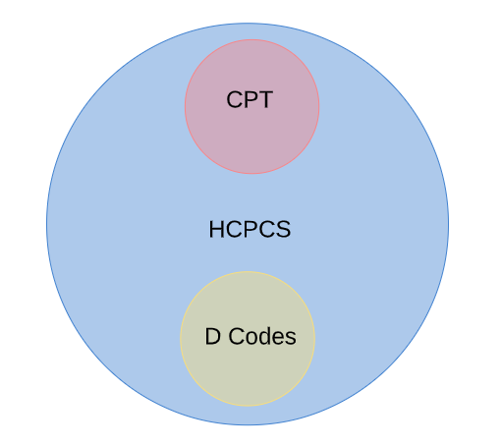
HCPCS CODE SET FOR UB-04 AND 1500 CLAIMS
HCPCS stands for Healthcare Common Procedural Coding System
HCPCS were originally divided into three Levels
Level I – CPT codes and CDT codes. CPT codes are maintained, published and copyrighted by the AMA. CDT codes are maintained, published and copyrighted by the ADA.
Level II – HCPC codes. HCPC codes are maintained and published by CMS.
Level III – Local codes. Local codes were maintained by Medicare & Medicaid payment contractors. Code set was limited to W, X, Y and Z series. Officially eliminated December 31, 2003 to meet HIPAA code set compliance standards. However, local codes are still in use for state programs and some private payors.
HCPCS codes are required for Part B claims and outpatient Part A claims.
HCPCS codes are for procedures and equipment/devices, and lack anything related to diagnosis.

Slide 7
Example cpt, Dental, and HCPCS
CPT Codes
12001 – Simple repair of superficial wounds of scalp, neck, axillae, external genitalia, trunk and/or extremities.
28510 – Closed treatment of fracture, phalanx or phalanges, other than great toe, without manipulation
Dental Codes
D1352 – Preventative resin restoration
D0272 – Bitewings – two radiographic images
HCPCS Codes
G0168 – Wound closure utilizing tissue adhesives only.
Q0081 – Infusion therapy other than chemotherapy.

Slide 8
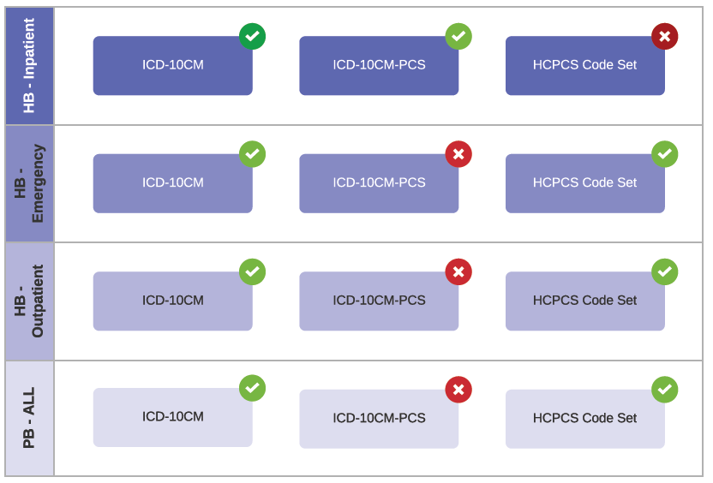
Epic account class map to claim type code sets (in general)

Slide 9
Icd-10cm-pcs deep dive
Multiaxial power house

Slide 10
Example icd-10cm-pcs codeS
03CH3Z7
Extirpation of Matter from Right Common Carotid Artery using Stent Retriever, Percutaneous Approach
9WB4XFZ
Chiropractic Manipulation of Sacrum, Direct Visceral
B32R0ZZ
Computerized Tomography (CT Scan) of Intracranial Arteries using High Osmolar Contrast

Slide 11
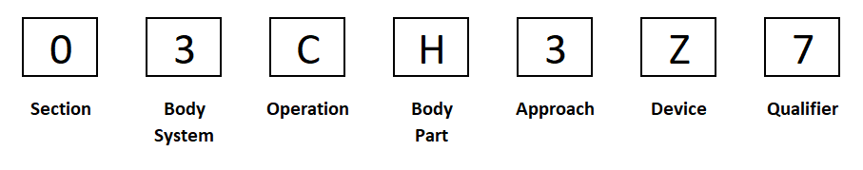
Icd-10cm-pcs multiaxial structure
Each character represents a specific element axis.
Each element axis has multiple alpha numeric options.

Slide 12
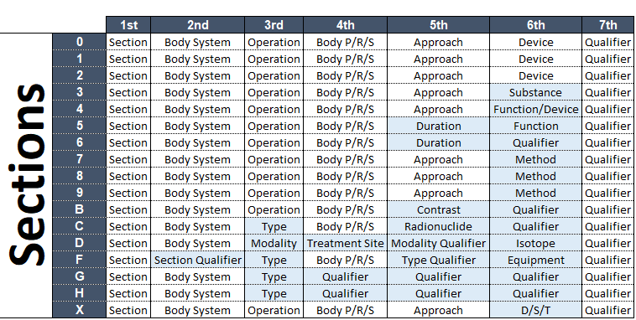
Character position definitions
The letters I and O are not used.
The letter Z is defined as None for all character positions 2 through 7.

Slide 13
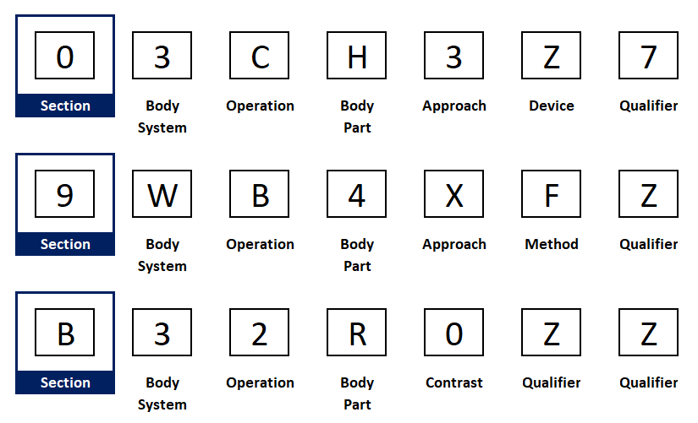
Position 1 - Section
0 Medical and Surgical
1 Obstetrics
2 Placement
3 Administration
4 Measurement and Monitoring
5 Extracorporeal or Systemic Assistance and Performance
6 Extracorporeal or Systemic Therapies
7 Osteopathic
8 Other Procedures
9 Chiropractic
B Imaging
C Nuclear Medicine
D Radiation Therapy
F Physical Rehabilitation and Diagnostic Audiology
G Mental Health
H Substance Abuse Treatment
X New Technology

Slide 14
Section code volumes
67,754 Medical and Surgical codes all starting with 0.
304 Obstetrics codes all starting with 1.
861 Placement codes all starting with 2.
1,253 Administration codes all starting with 3.
422 Measurement and Monitoring codes all starting with 4.
52 Extracorporeal or Systemic Assistance and Performance codes all starting with 5.
46 Extracorporeal or Systemic Therapies codes all starting with 6.
100 Osteopathic codes all starting with 7.
78 Other codes all starting with 8.
90 Chiropractic codes all starting with 9.
2,977 Imaging codes all starting with B.
463 Nuclear Medicine codes all starting with C.
2,087 Radiation Therapy codes all starting with D.
1,380 Physical Rehabilitation and Diagnostic Audiology codes that all start with F.
30 Mental Health codes that all start with G.
59 Substance Abuse Treatment codes that all start with H.
271 New Technology codes that all start with X.

Slide 15
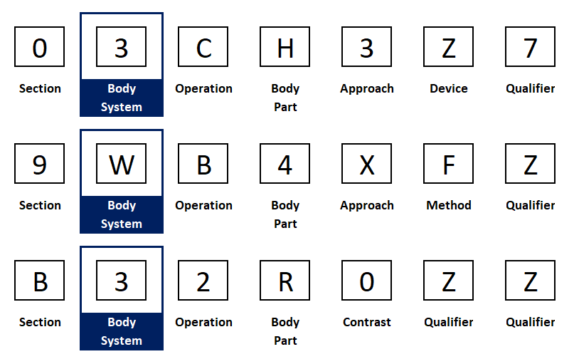
Position 2 - Body system or section qualifier
Each section character and body system character form a unique pair.
03 – Medical & Surgical – Upper Arteries
9W – Chiropractic – Anatomical Regions
B3 – Imaging – Upper Arteries
There are 31 body system options in the Medical & Surgical section, 1 in the Chiropractic section, and 23 in the Imaging section.
A body system character, “3” for example, will have the same meaning across sections that have the same definition where possible, but not always.
Section F uses Section Qualifier which is either Physical Rehabilitation (F0) or Diagnostic Audiology (F1).

Slide 16
Body system for medical & surgical section
0 Central Nervous
1 Peripheral Nervous
2 Heart & Great Vessels
3 Upper Arteries
4 Lower Arteries
5 Upper Veins
6 Lower Veins
7 Lymphatic & Hemic
8 Eye
9 Ears, Nose, Sinus
B Respiratory
C Mouth & Throat
D Gastrointestinal
F Hepatobiliary & Pancreas
G Endocrine
H Skin & Breast
J Subcutaneous Tissue & Fascia
K Muscles
L Tendons
M Bursae & Ligaments
N Head & Facial Bones
P Upper Bones
Q Lower Bones
R Upper Joints
S Lower Joints
T Urinary
U Female Reproductive
V Male Reproductive
W Anatomical Regions, General
X Anatomical Regions, Upper
Y Anatomical Regions, Lower

Slide 17
Body systems for Chiropractic and imaging
Chiropractic
9W Anatomical Regions
Imaging (23 Total)
B0 Central Nervous System; B2 Heart; B3 Upper Arteries; B4 Lower Arteries; B5 Veins; B7 Lymphatic System; B8 Eye; B9 Ear, Nose, Mouth and Throat; BB Respiratory System; BD Gastrointestinal System; BF Hepatobiliary System and Pancreas; BG Endocrine System; BH Skin, Subcutaneous Tissue and Breast; BL Connective Tissue; BN Skull and Facial Bones; BP Non-Axial Upper Bones; BQ Non-Axial Lower Bones; BR Axial Skeleton (esfb); BT Urinary System; BU Female Reproductive System; BV Male Reproductive System; BW Anatomical Regions; BY Fetus and Obstetrical

Slide 18
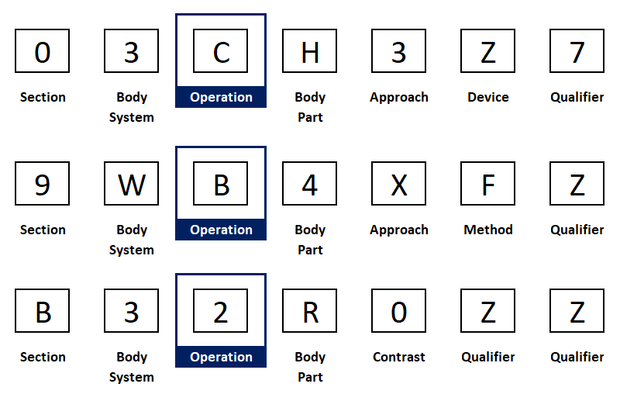
Position 3 - Root operation or modality or type
Position three states the objective of the procedure.
03C – Medical & Surgical – Upper Arteries - Extirpation
9WB – Chiropractic – Anatomical Regions - Manipulation
B32 – Imaging – Upper Arteries – CT Scan
Each root operation/modality/type has a specific definition.
Each section has root operations/modalities/types specific to that section.

Slide 19
Root operations for medical & surgical section
0?0 Alteration
0?1 Bypass
0?2 Change
0?3 Control
0?4 Creation
0?5 Destruction
0?6 Detachment
0?7 Dilation
0?8 Division
0?9 Drainage
0?B Excision
0?C Extirpation
0?D Extraction
0?F Fragmentation
0?G Fusion
0?H Insertion
0?J Inspection
0?K Map
0?L Occlusion
0?M Reattachment
0?N Release
0?P Remove
0?Q Repair
0?R Replace
0?S Reposition
0?T Resection
0?U Supplement
0?V Restriction
0?W Revise
0?X Transfer
0?Y Transplantation

Slide 20
Root operations for Chiropractic and imaging
Chiropractic
9WB Manipulation
Imaging
B?0 Plain Radiography
B?1 Fluoroscopy
B?2 CT Scan
B?3 MRI
B?4 Ultrasonography
B?5 Other Imaging

Slide 21
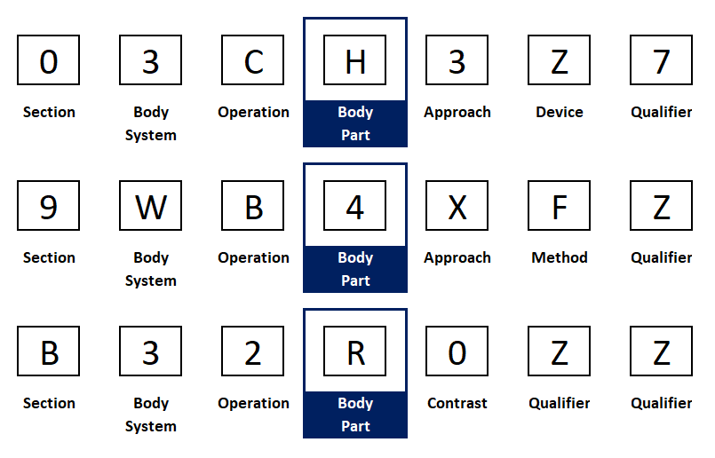
Position 4 - body part/region/system or qualifier
Body Part is exactly what the name implies. Every single bone, muscle, tendon, artery, vein, organ part, nerve, digit, extremity, etc., in and on the body, is included.
Body part is limited by the Body System character. You will not see bones in the Upper Arteries.
For multiple body parts, left, right, and bilateral are considered different and each has a separate body part letter/number.
Section D uses treatment site rather than body part.
The concept of body part is not applicable to sections G and H. All codes in these two sections have Z in the fourth position.

Slide 22
Body Parts for 03 – Upper arteries BODY sYSTEM
03?0 Internal Mammary Artery, R
03?1 Internal Mammary Artery, L
03?2 Innominate Artery
03?3 Subclavian Artery, Right
03?4 Subclavian Artery, Left
03?5 Axillary Artery, Right
03?6 Axillary Artery, Left
03?7 Brachial Artery, Right
03?8 Brachial Artery, Left
03?9 Ulnar Artery, Right
03?A Ulnar Artery, Left
03?B Radial Artery, Right
03?C Radial Artery, Left
03?D Hand Artery, Right
03?F Hand Artery, Left
03?G Intracranial Artery
03?H Common Carotid Artery, R
03?J Common Carotid Artery, L
03?K Internal Carotid Artery, R
03?L Internal Carotid Artery, L
03?M External Carotid Artery, R
03?N External Carotid Artery, L
03?P Vertebral Artery, Right
03?Q Vertebral Artery, Left
03?R Face Artery
03?S Temporal Artery, Right
03?T Temporal Artery, Left
03?U Thyroid Artery, Right
03?V Thyroid Artery, Left
03?Y Upper Artery

Slide 23
Body Parts for 9W Chiropractic and B3 imaging Upper arteries
9WB Manipulation
B3? Imaging Upper Arteries
0 Head
1 Cervical
2 Thoracic
3 Lumbar
4 Sacrum
5 Pelvis
6 Lower Extremities
7 Upper Extremities
8 Rib Cage
9 Abdomen
B3?0 Thoracic Aorta
B3?1 Brachiocephalic-Subclavian Artery, R
B3?2 Subclavian Artery, Left
B3?3 Common Carotid Artery, R
B3?4 Common Carotid Artery, L
B3?5 Common Carotid Arteries, Bilateral
B3?6 Internal Carotid Artery, R
B3?7 Internal Carotid Artery, L
B3?8 Internal Carotid Arteries, Bilateral
B3?9 External Carotid Artery, R
B3?B External Carotid Artery, L
B3?C External Carotid Arteries, Bilateral
B3?D Vertebral Artery, Right
B3?F Vertebral Artery, Left
B3?G Vertebral Arteries, Bilateral
B3?H Upper Extremity Arteries, Right
B3?J Upper Extremity Arteries, Left
B3?K Upper Extremity Arteries, Bilateral
B3?L Intercostal and Bronchial Arteries
B3?M Spinal Arteries
B3?N Upper Arteries, Other
B3?P Thoraco-Abdominal Aorta
B3?Q Cervico-Cerebral Arch
B3?R Intracranial Arteries
B3?S Pulmonary Artery, Right
B3?T Pulmonary Artery, Left
B3?U Pulmonary Trunk
B3?V Ophthalmic Arteries

Slide 24
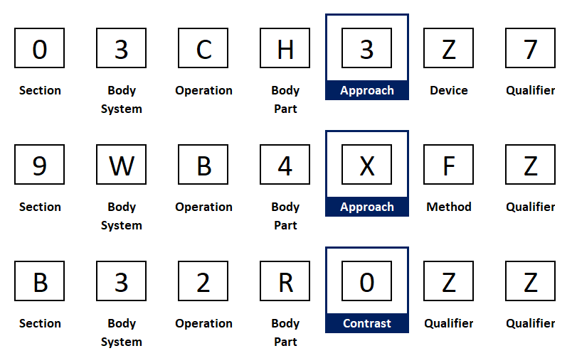
Position 5 - technique
Technically, the fifth character in an ICD-10CM-PCS code represents the technique used to access the body part. Personally, I think of it more as how did you do it?
The section determines the definition and value options for the fifth character. This will make more sense when we look at the 1st & 5th character options on the next slides.

Slide 25
Sections using approach definition
Sections
Approach Options
0 Medical and Surgical
1 Obstetrics
2 Placement
3 Administration
4 Measurement and Monitoring
7 Osteopathic
8 Other Procedures
9 Chiropractic
X New Technology
0 Open
3 Percutaneous
4 Percutaneous Endoscopic
7 Via Natural or Artificial Opening
8 Via Natural or Artificial Opening Endoscopic
F Via Natural or Artificial Opening Endoscopic with Percutaneous Endoscopic Assistance
X External

Slide 26
Sections using duration definition
5 Extracorporeal or Systemic Assistance and Performance
6 Extracorporeal or Systemic Therapies
5???0 Single
5???1 Intermittent
5???2 Continuous
5???3 Less than 24 Consecutive Hours
5???4 24-96 Consecutive Hours
5???5 Greater than 96 Consecutive Hours
5???6 Multiple
5???7 Intermittent, Less than 6 Hours Per Day
5???8 Prolonged Intermittent, 6-18 Hours Per Day
5???9 Continuous, Greater than 18 Hours Per Day
5???A Intraoperative
6???0 Single
6???1 Multiple

Slide 27
Imaging, nuclear medicine, radiation therapy
B??? Imaging: Contrast: 0 High Osmolar; 1 Low Osmolar; 2 Fluorescing Agent; Y Other Contrast; Z None
C??? Nuclear Medicine: Radionuclide: 1 Technetium 99m; 7 Cobalt 58; 8 Samarium 153; 9 Krypton; B Carbon 11; C Cobalt 57; D Indium 111; F Iodine 123; G Iodine 131; H Iodine 125; K Fluorine18; L Gallium 67; M Oxygen 15; N Phosphorus 32; P Strontium 89; Q Rubidium 82; R Nitrogen 13; S Thallium 201; T Xenon 127; V Xenon 133; W Chromium; Y Other Radionuclide; Z None
D??? Radiation Therapy: Modality Qualifier: 0 Photons <1 MeV; 1 Photons 1 – 10 MeV; 2 Photons >10 MeV; 3 Electrons; 4 Heavy Particles (Protons, Ions); 5 Neutrons; 6 Neutron Capture; 7 Contact Radiation; 8 Hyperthermia; 9 High Does Rate; B Low Dose Rate; C Intraoperative Radiation Therapy; D Stereotactic Other Photon Radiosurgery; F Plaque Radiation; G Isotope Administration; H Stereotactic Particulate Radiosurgery; J Stereotactic Gamma Beam Radiosurgery; K Laser Interstitial Thermal Therapy

Slide 28
Physical Rehabilitation & diagnostic audiology Type
The Physical Rehabilitation and Diagnostic Audiology Section (F) utilize the fifth character position but are very different from the other sections.
For Section F, the fifth character position is dependent on the all of the preceding characters, not just the section character.
This specificity leads to an enormous number of options. Too many options to go into during this presentation.

Slide 29
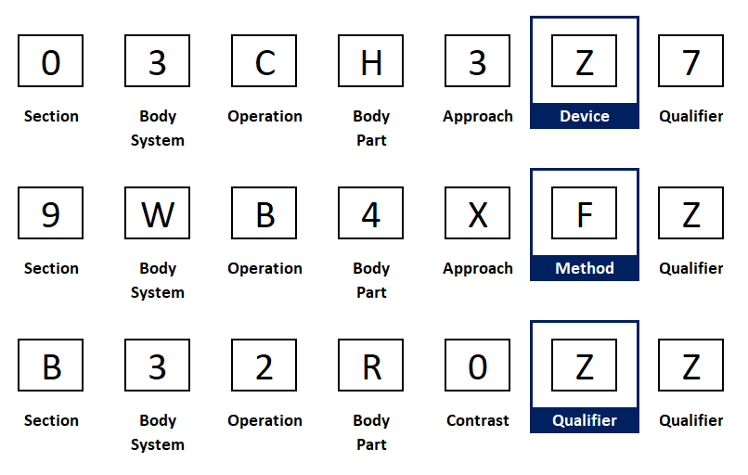
Position 6 – stays with the patient
The sixth character in an ICD-10CM-PCS code represents devices that remain after the root operation is completed. Materials incidental to the procedure are not coded as devices.
There are four general types of devices
Biological or synthetic material that takes the place of all or a portion of a body part.
Biological or synthetic material that assists or prevents a physiological function.
Therapeutic material that is not absorbed by, eliminated by, or incorporated into a body part.
Mechanical or electronic appliances used to assist, monitor, take the place of or prevent a physiological function.

Slide 30
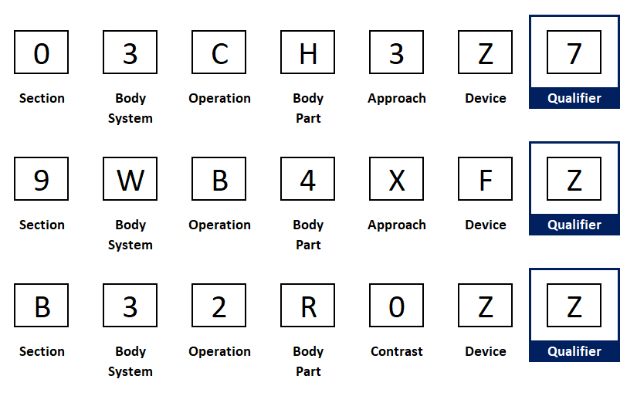
Position 7 – qualifier
The seventh character in an ICD-10CM-PCS code is the qualifier. The qualifier will create a unique value for individual procedures when the other six characters are not enough.
The qualifier value for most codes is Z – none.
The qualifier for our Medical & Surgical (Section 0) example code represents the stent retriever mentioned in the code description.
Also in Section 0, the qualifier field can be used to identify the destination site for bypass procedures.

Slide 31
How do we use this??
How many invasive knee surgeries did we have last year? Hint: Invasive = open.
What is the average length in minutes by doc to put in a new pacemaker?? Hint – you are going to need to clarify several data point options. device., body part, new insert, remove/insert, etc.
What is the post-op infection rate for hot vs blown appies? Hint – you need both diagnosis and PCS codes.
The most amazing case I know of: A friend from college reached out for help with a mysterious infection problem in his OR wing. Took just over a year to finally get to the root cause. Source of infection was filtration failure in ventilation system. Pattern started with the right or left in the PCS procedure, expanded to OR suite (north or east) and then to surgeon handing (right or left).

Slide 32
Resources
CDC – National Center for Health Statistics – ICD-10-CM
https://www.cdc.gov/nchs/icd/icd10cm.htm
CMS – 2022 ICD-10 PCS
https://www.cms.gov/medicare/icd-10/2022-icd-10-pcs
CMS – HCPCS Quarterly Updates
https://www.cms.gov/Medicare/Coding/HCPCSReleaseCodeSets/HCPCS-Quarterly-Update

